Slide 1
Product Development Project
Team 10
Anurag Deepak
Chandan
Jegannath
Naveen
Rajadurai
Guided by
Ashley Francis

Slide 2
Bank Statement Data Extractor
Extract data from credit card or bank statements and provide analytic and trends for a customer.
Input : CSV file of a bank statement
Output : Data Visualization of customer analytics

Slide 3
Technical Platforms Used
UI/UX - Angular CLI
Database - MongoDB
API - Flask
Data Visualization - Plotly with Python
Environment - Anaconda

Slide 4
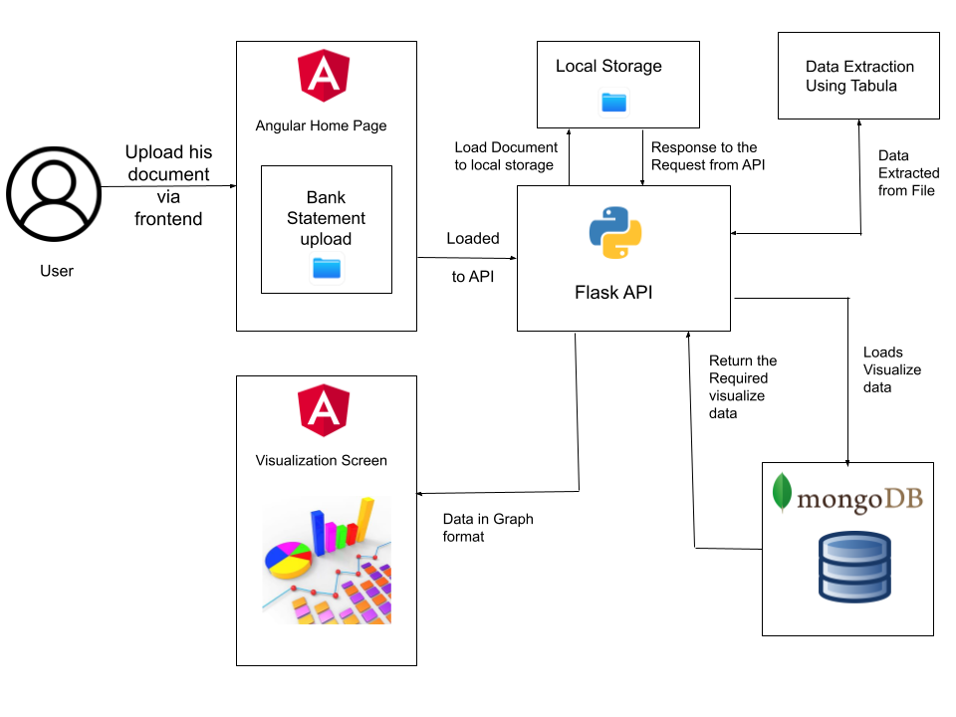
Arechitrcture Representation

Slide 5
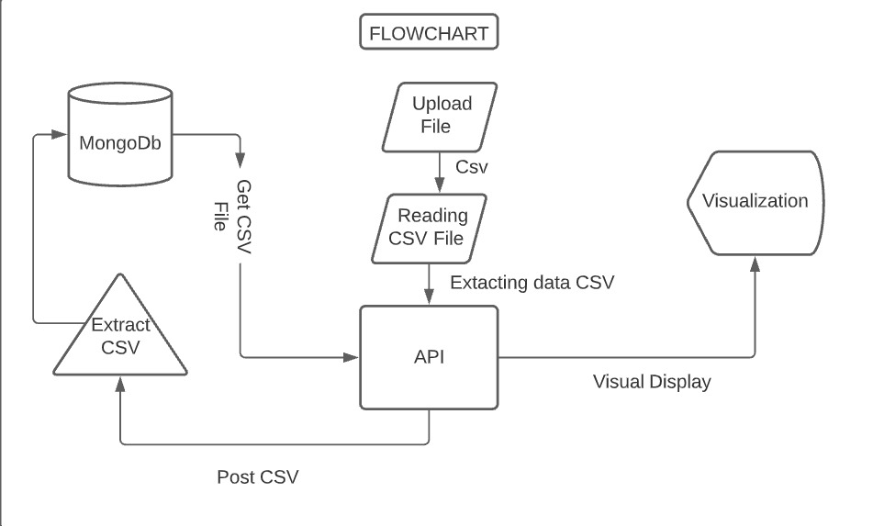
Flowchart

Slide 6
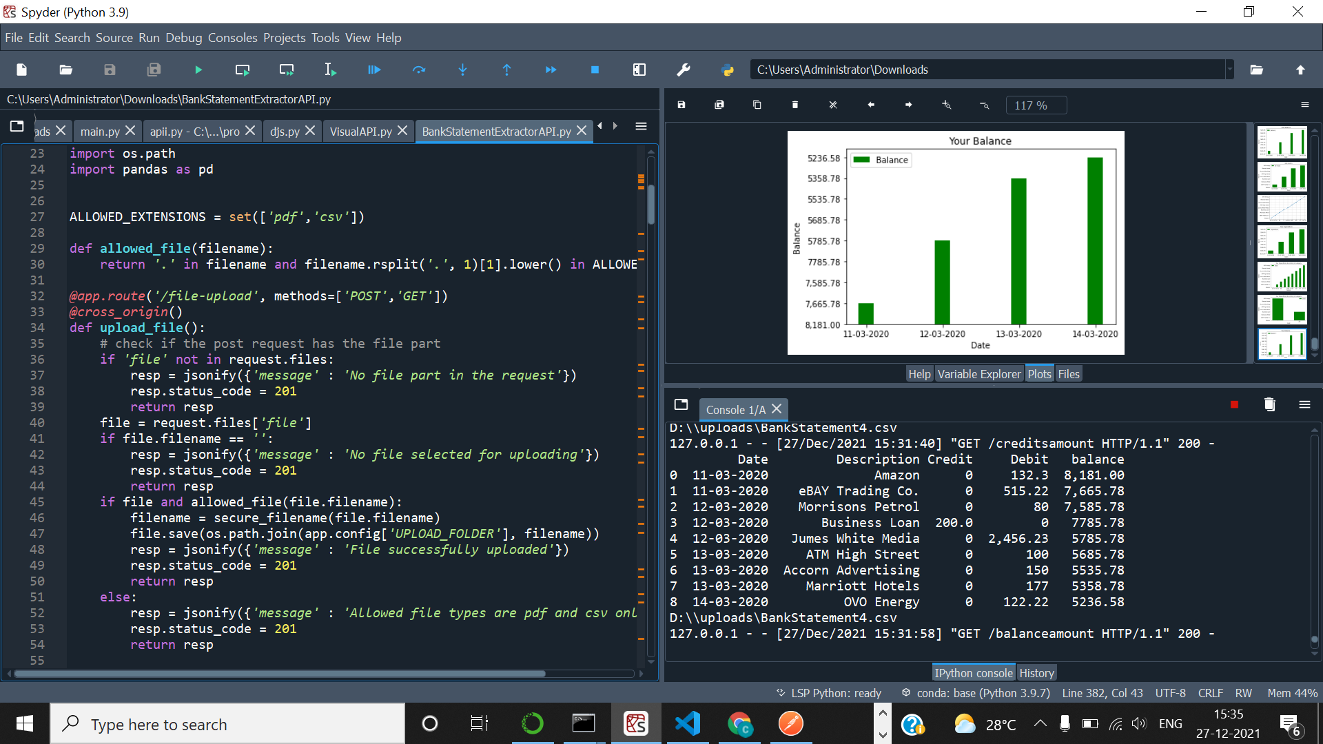
File Uploading API
The file gets uploaded in the API with the following code.
The following code will validate the file (csv) extension if the condition is true then it will be pushed into the local storage

Slide 7
Process
The file uploaded from frontend which be loaded in the api by angular and stored in local storage(New Folder will be created).
Then after requesting files from flask api the data is loaded into mongo db upon requesting data from frontend the mongo db posts the visualized data respones.
Then the data is processed using Plotly for various form of visualization.

Slide 8
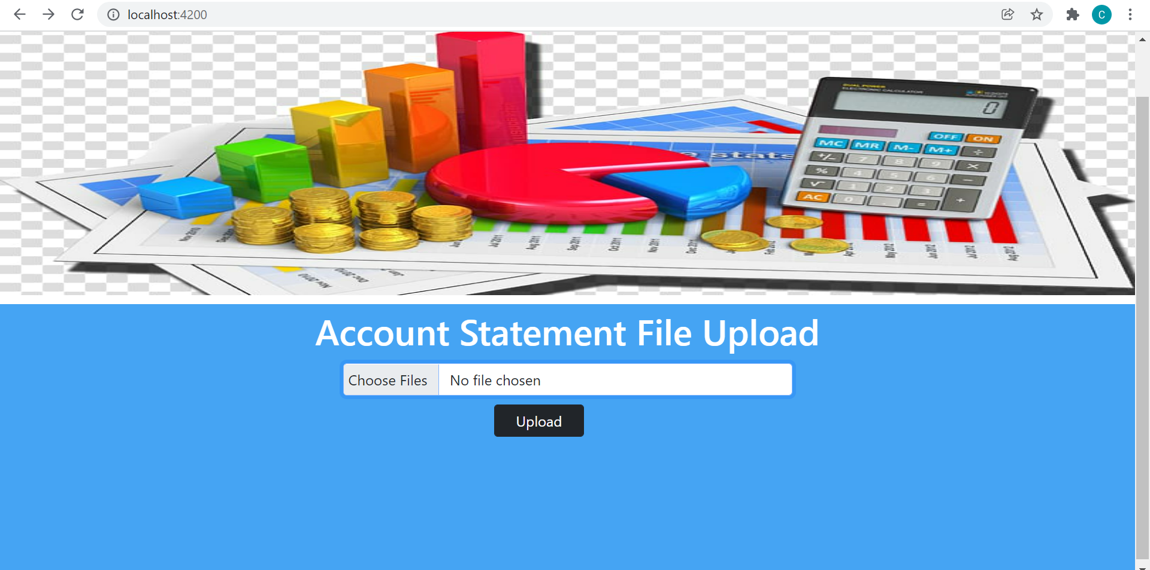
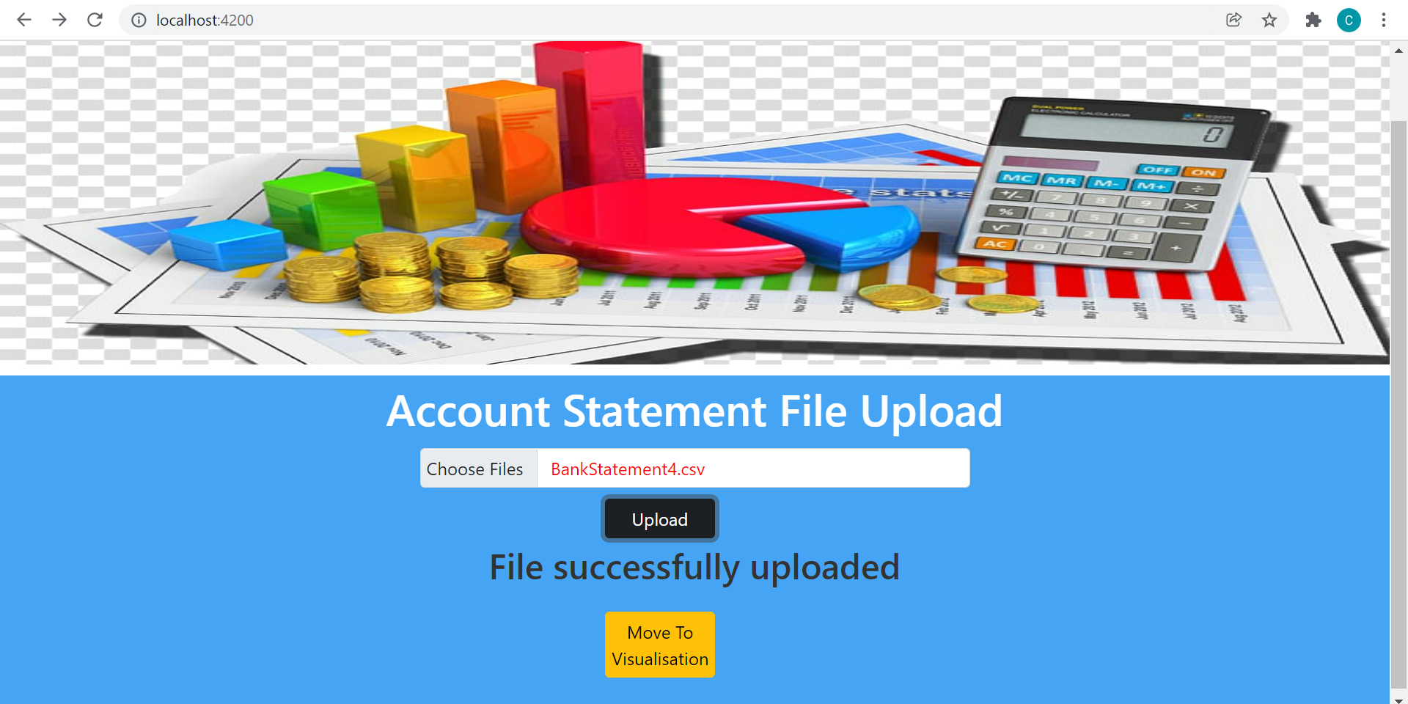

Frontend Output
File Uploading Process
Uploaded File

Slide 9
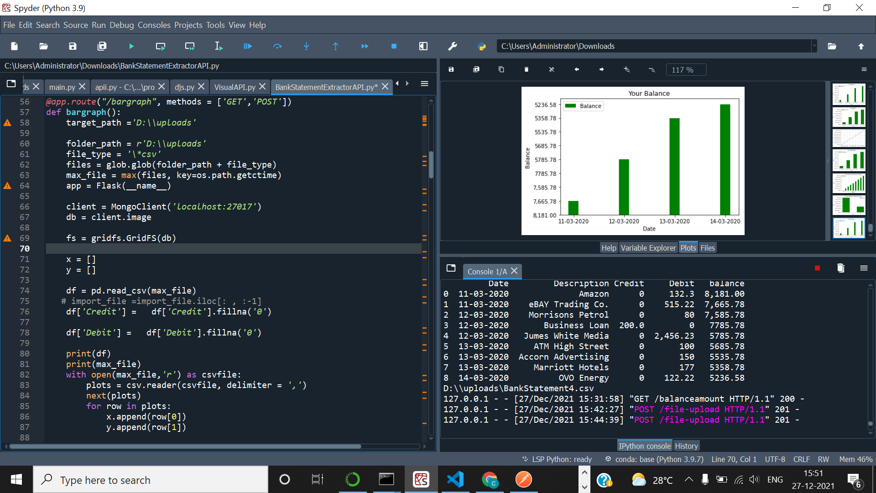
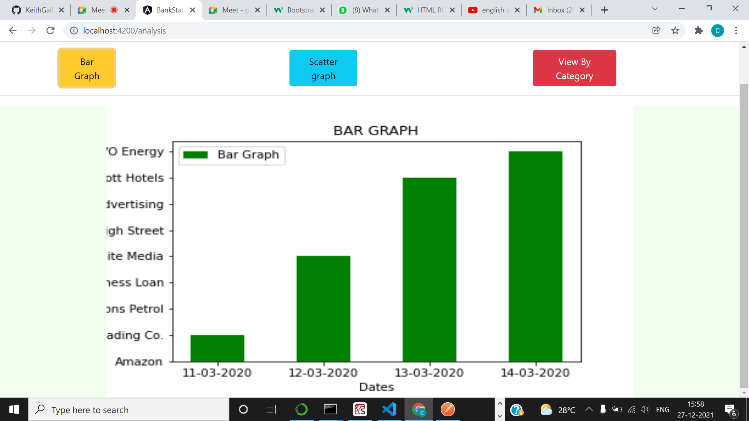
Ptotly - Bar Chart

Slide 10
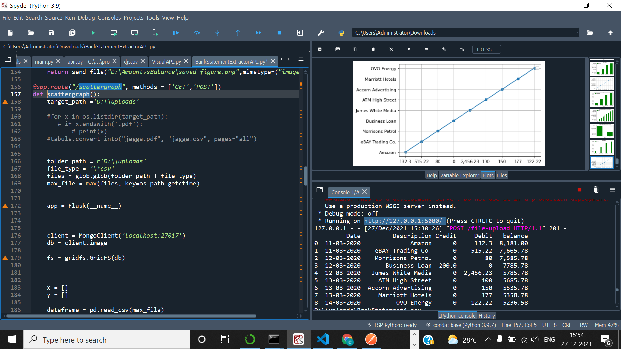
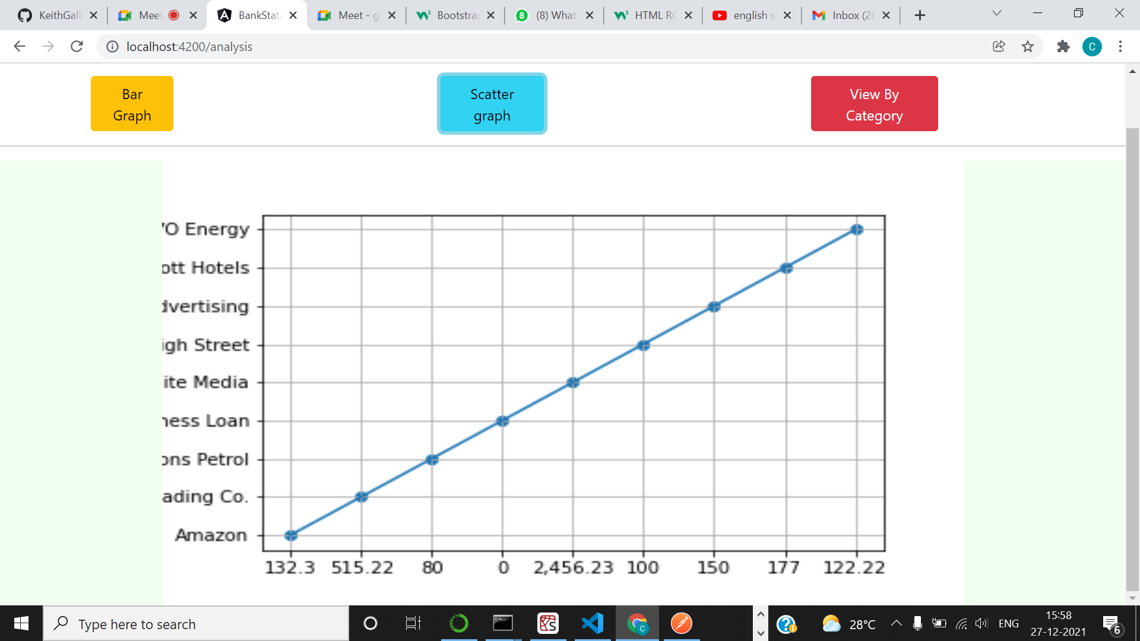
Plotly - Scatter Plot

Slide 11
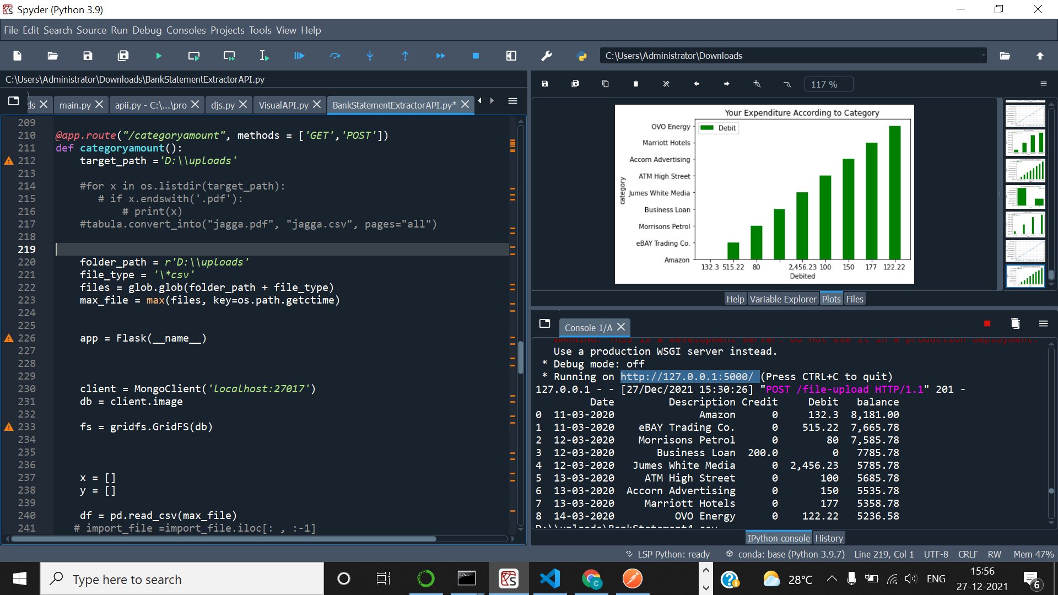
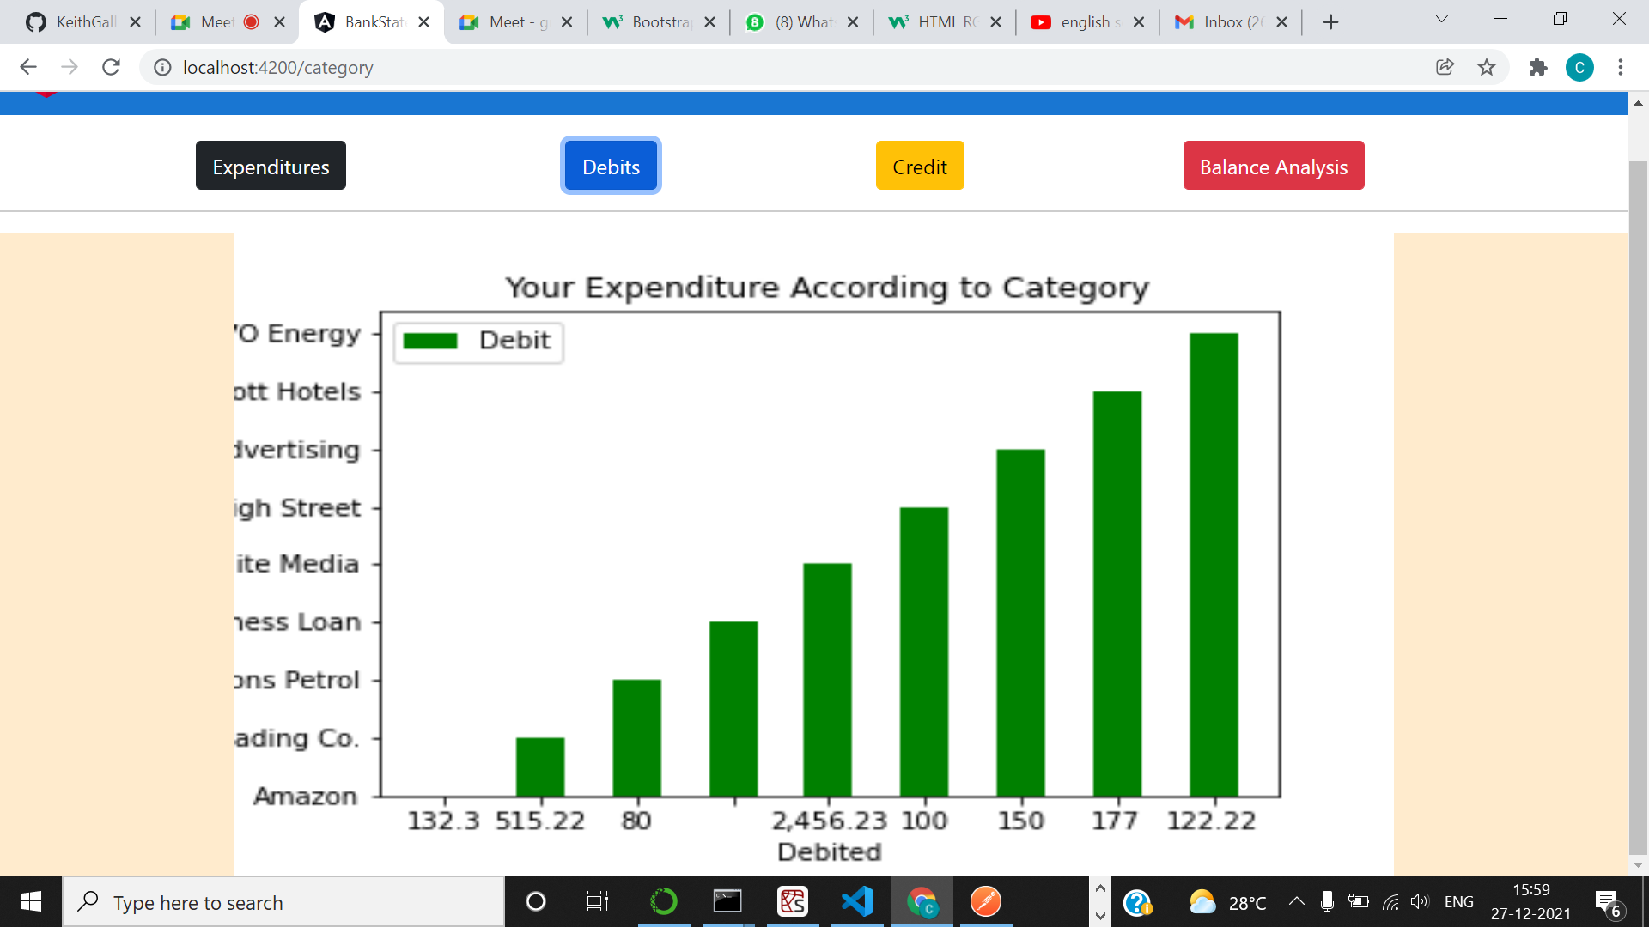
Ploty - Expenses Analysis

Slide 12
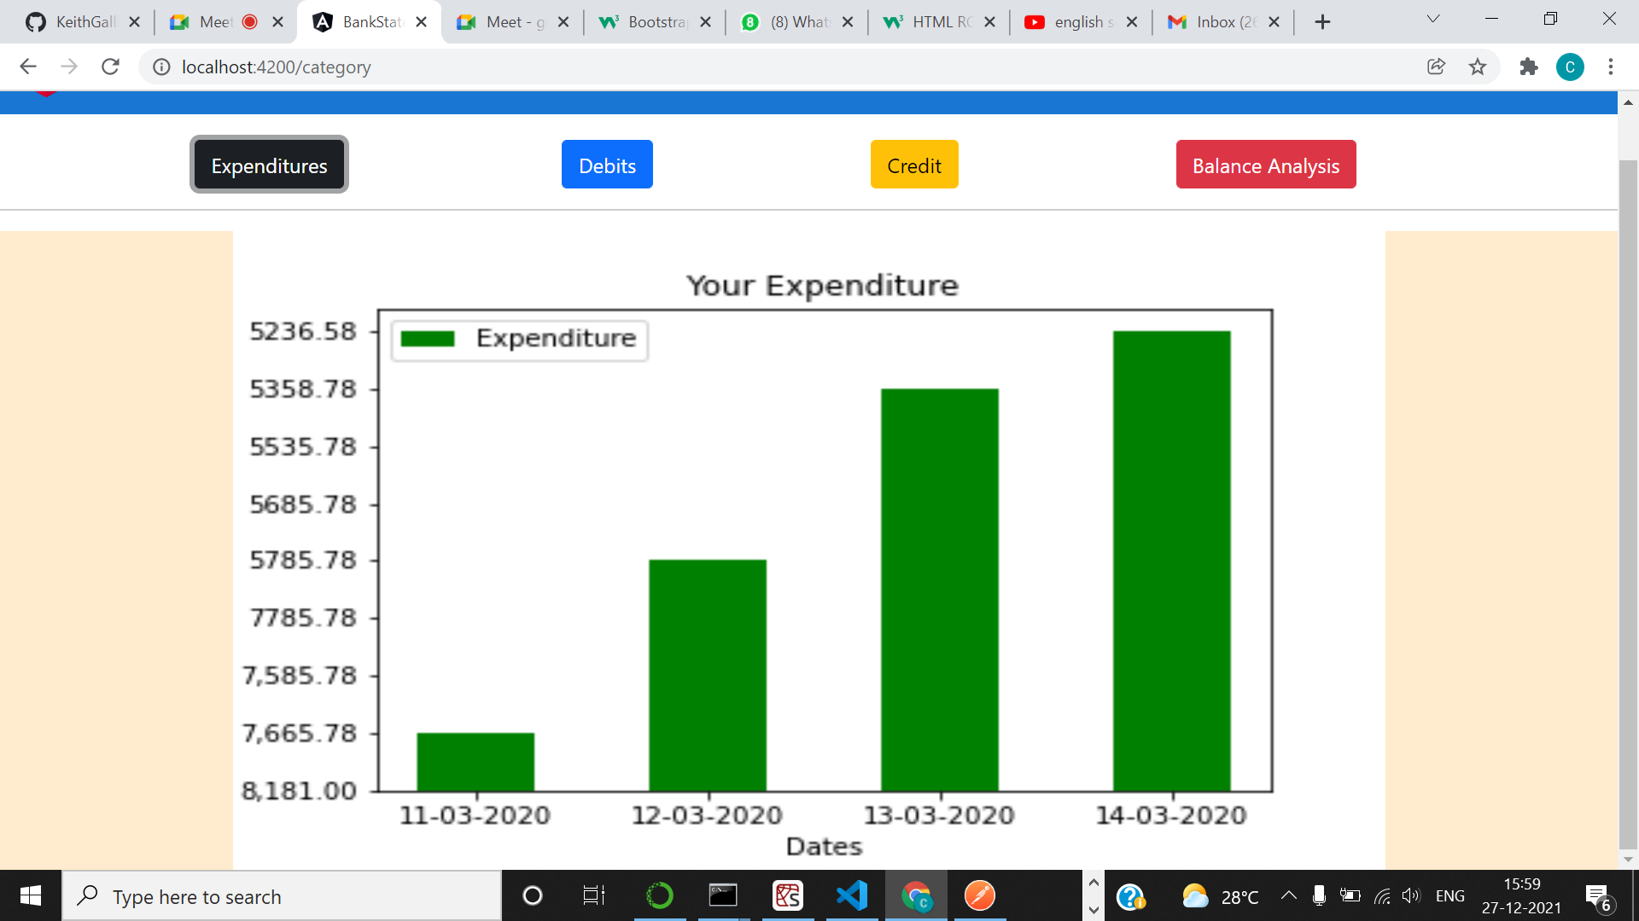
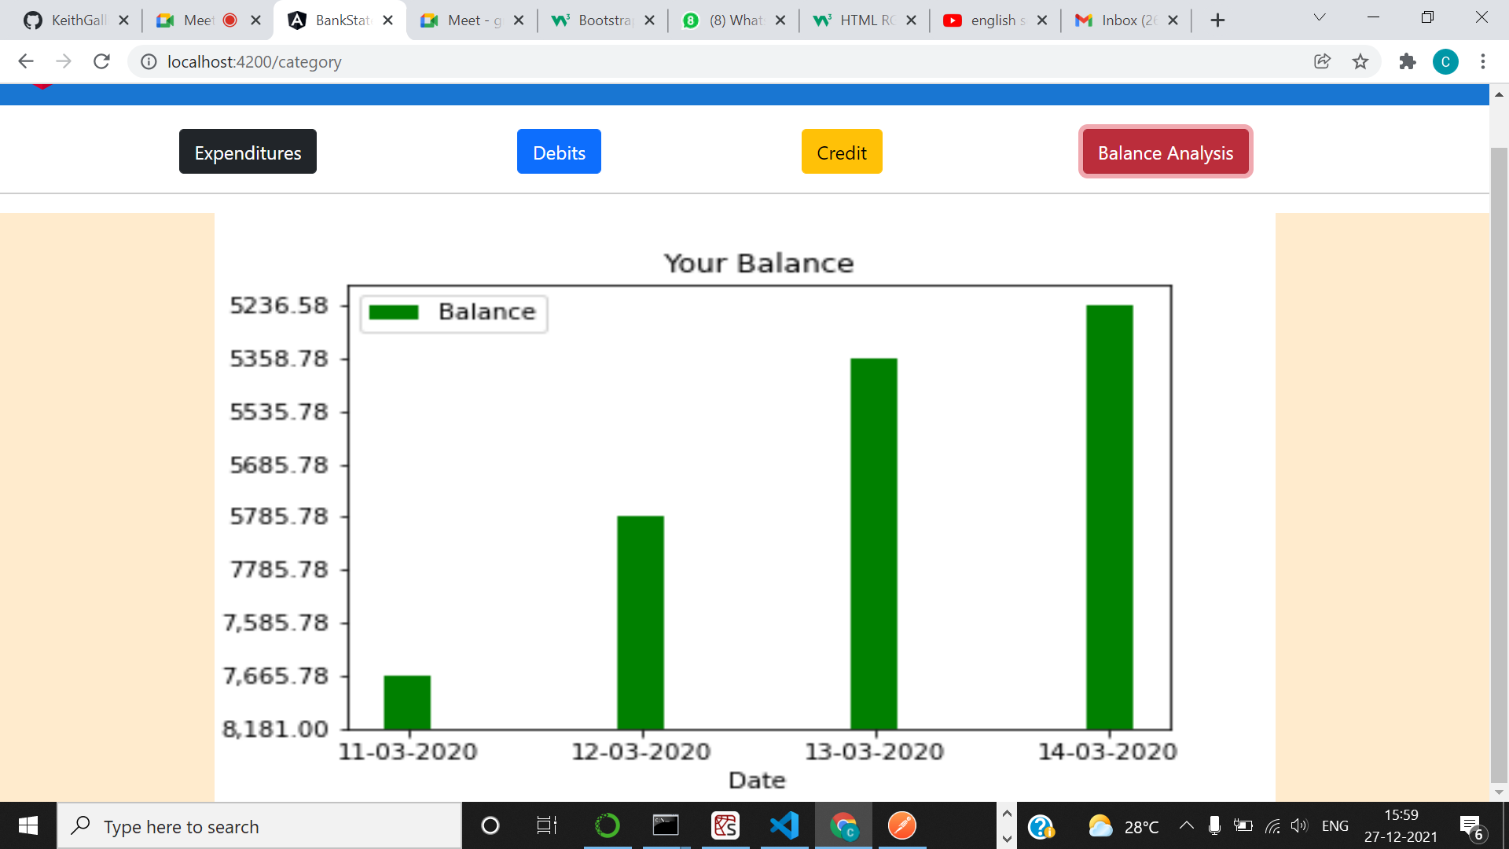
Other categories of data visualization

Slide 13
THANK YOU

